Slide 1
Discussion 10
DFS, BFS, SPs, MSTs

Slide 2
Announcements
Welcome back from spring break! Hope you had a restful week :)
Reach out to your mentor GSI if you feel yourself falling behind, or are feeling overwhelmed -- we’re here for you! We want to help you finish as strong as you can.
We will be running the full autograder for project 2AB on ~4/2
Midterm 2 this Friday, April 5th from 8-10pm!
Check out @3764 for important information about the midterm & review sessions!
No lab due this week! We’ll be doing exam review in lab.
61B Imposter Syndrome Panel
Sunday, 4/7 from 5-6:30pm in Soda 310
Remember to complete the anonymous spring break survey for 8 points of EC!
Discussion survey: tinyurl.com/cz-disc10-sp19

Slide 3
Table of Contents
Slide 4: Graph Traversals Overview
Slide 8: Q1.1 Solution
Slide 25: Dijkstra’s Overview
Slide 28: Q2.1 Solution
Slide 41: A* Search Overview
Slide 44-45: Q2.2 & Q2.3 Solution
Slide 46-48: MSTs + Prims v. Kruskal’s
Slide 50: Q3.1 Solution
Slide 55: Q3.2 Solution

Slide 4
Agenda
Focus on what has the highest votes, but we’ll try to get through everything!

Slide 5
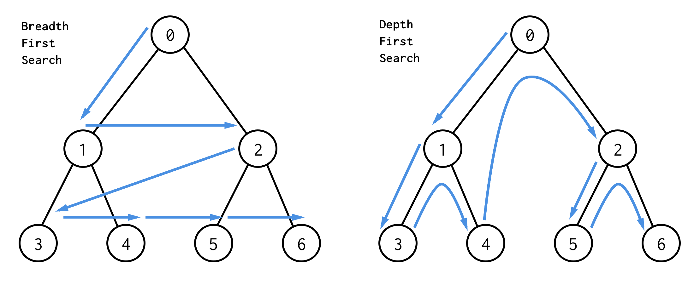
Graph Traversals
Level-Order/Breadth First Search (BFS):
Visit top to bottom, left to right, just like how you read!
Depth-order/Depth First Search (DFS):
Traverse “deeper” nodes before shallow ones

Slide 6
Preorder vs. Postorder vs. Inorder (all types of DFS)
Preorder: “Visit” a node, then traverse its children
Inorder: Traverse left child, “visit” node, then traverse right child
Postorder: Traverse children, then “visit” node.
Note: The prefix to order (pre, in, post) refers to when a node is visited with respect to its children
ex) That’s why postorder means that we visit the node AFTER we visit the children (post is a prefix, meaning “behind,” “after,”)
Note: Node and vertex are used interchangeably.

Slide 7
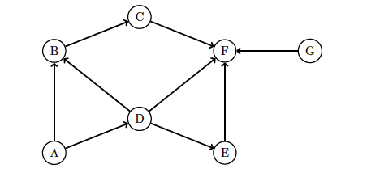
Q1.1: Graphs
Give the DFS preorder, DFS postorder, and BFS order of the graph traversals starting from vertex A. Break ties alphabetically.

Slide 8
Q1.1: Implementing Post/Preorder
Maintain a stack of nodes and a marked set.
As soon as we add something to our stack, we note it for preorder.
The top node in our stack represents the node we are currently on, and the marked set represents nodes that have been visited.
After we add a node to the stack, we visit its lexicographically next unmarked child.
If there is none, we pop the topmost node from the stack and note it down for postorder.

Slide 9
Q1.1: DFS Pre/postorder Solution
remember: the node on the top of the stack is the node we’re currently on
C
Stack: A
Marked Set: A
Preorder: A
B
F
G
D
A
E
A has two unmarked children (B, D)
Going to add B (alphabetical) to our stack, preorder, and marked set.
(unmarked means the child is not in the Marked Set)

Slide 10
Q1.1: DFS Pre/postorder Solution
C
Stack: A B
Marked Set: A B
Preorder: A B
B
F
G
D
A
E
B has an unmarked child (C)
Going to add C to our stack, preorder, and marked set.

Slide 11
Q1.1: DFS Pre/postorder Solution
C
Stack: A B C
Marked Set: A B C
Preorder: A B C
B
F
G
D
A
E
C has an unmarked child (F)
Going to add F to our stack, preorder, and marked set.

Slide 12
Q1.1: DFS Pre/postorder Solution
C
Stack: A B C F
Marked Set: A B C F
Preorder: A B C F
B
F
G
D
A
E

Slide 13
Q1.1: DFS Pre/postorder Solution
C
Stack: A B C F
Marked Set: A B C F
Preorder: A B C F
B
F
G
D
A
E
F has no unmarked children
Pop from the stack (F) and note it down for postorder.

Slide 14
Q1.1: DFS Pre/postorder Solution
C
Stack: A B C
Marked Set: A B C F
Preorder: A B C F
Postorder: F
B
F
G
D
A
E
C has no unmarked children
Pop from the stack (C) and note it down for postorder.

Slide 15
Q1.1: DFS Pre/postorder Solution
C
Stack: A B
Marked Set: A B C F
Preorder: A B C F
Postorder: F C
B
F
G
D
A
E
B has no unmarked children
Pop from the stack (B) and note it down for postorder.

Slide 16
Q1.1: DFS Pre/postorder Solution
C
Stack: A
Marked Set: A B C F
Preorder: A B C F
Postorder: F C B
B
F
G
D
A
E
A has an unmarked child (D)
Going to add D to our stack, preorder, and marked set.

Slide 17
Q1.1: DFS Pre/postorder Solution
C
Stack: A D
Marked Set: A B C F D
Preorder: A B C F D
Postorder: F C B
B
F
G
D
A
E
D has an unmarked child (E)
Going to add E to our stack, preorder, and marked set.

Slide 18
Q1.1: DFS Pre/postorder Solution
C
Stack: A D E
Marked Set: A B C F D E
Preorder: A B C F D E
Postorder: F C B
B
F
G
D
A
E
E has no unmarked children
Pop from the stack (E) and note it down for postorder.

Slide 19
Q1.1: DFS Pre/postorder Solution
C
Stack: A D
Marked Set: A B C F D E
Preorder: A B C F D E
Postorder: F C B E
B
F
G
D
A
E
D has no unmarked children
Pop from the stack (D) and note it down for postorder.

Slide 20
Q1.1: DFS Pre/postorder Solution
C
Stack: A
Marked Set: A B C F D E
Preorder: A B C F D E
Postorder: F C B E D
B
F
G
D
A
E
A has no unmarked children
Pop from the stack (A) and note it down for postorder.

Slide 21
Q1.1: DFS Pre/postorder Solution
C
Stack: empty
Marked Set: A B C F D E (G)
Preorder: A B C F D E (G)
Postorder: F C B E D A (G)
B
F
G
D
A
E

Slide 22
Q1.1: BFS Solution
BFS: A
Marked Set: A
C
B
F
G
D
A
E
Start at A. Add to BFS order & mark it.
Consider all unmarked nodes 1 edge away from A.

Slide 23
Q1.1: BFS Solution
BFS: A B D
Marked Set: A B D
C
B
F
G
D
Add B and D to BFS order & mark them.
Consider all unmarked nodes 1 edge away from B and D. Note that B is 1 edge away but is marked.
A
E

Slide 24
Q1.1: BFS Solution
BFS: A BD CEF
Marked Set: A B D C E F
C
B
F
G
D
A
E
Add C, E, and F to BFS order & mark them.
Consider all unmarked nodes 1 edge away from C, E, and F.

Slide 25
Q1.1: BFS Solution
BFS: A BD CEF (G)
Marked Set: A B D C E F (G)
C
B
F
G
D
A
E
There are none, so we’re done.

Slide 26
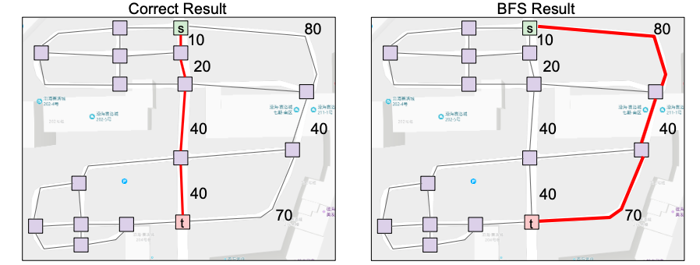
Dijkstra’s Algorithm
Suppose we want the shortest path from vertex A to any vertex B.
BFS doesn’t always give us the shortest path (see below)
We need something that accounts for the actual distances or edge distances/weights between vertices.
Notes:
Picture from Josh Hug’s Sp19 Lec 25 slides: https://docs.google.com/presentation/d/1X_HRo2Wr9FwFrzRcH8Ppq6L5r1bEGrlhLS2L9hY4-Ec/edit#slide=id.g54762a0157_0_261

Slide 27
Dijkstra’s Algorithm
Main Idea
Add all vertices to the PQ with priority infinity
Initialize starting vertex
Distance = PQ value = 0
Remove best vertex v from PQ, and relax all edges pointing from v.
Best: closest vertex, smallest distance to
Stop once there are no more items in PQ
Single source, multiple targets
It’s guaranteed to produce the correct result if all edges are non-negative.
Main idea: when you pop an element off fringe, it will be the shortest path to that element!
Always explore what is closest to us first, anything we find later must have a greater distance to because our edge weights are all positive
Dijkstra’s Algorithm Demo Link (from lecture 25)
Notes:
Content from Josh Hug’s Sp19 Lec 25 slides: https://docs.google.com/presentation/d/1X_HRo2Wr9FwFrzRcH8Ppq6L5r1bEGrlhLS2L9hY4-Ec/edit#slide=id.g54762a0157_0_261

Slide 28
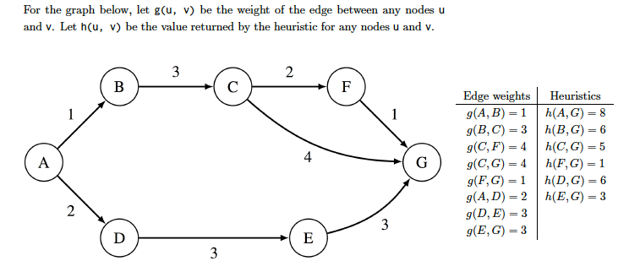
Q2.1: Dijkstra’s Algorithm

Slide 29
Q2.1: Dijkstra’s Algorithm Solution
Pop A.
3
2
B
C
F
Priority Queue | Distances | edgeTo
A: 0 | A: 0 | —
B: inf
C: inf
D: inf
E: inf
F: inf
G: inf
1
1
4
A
G
2
D
E
3
3

Slide 30
Q2.1: Dijkstra’s Algorithm Solution
changePriority(B, 1), changePriority(D, 2)
3
2
B
C
F
Priority Queue | Distances | edgeTo
A: 0 | A: 0 | —
B: 1 | B: 1 | A
D: 2 | D: 2 | A
C: inf
E: inf
F: inf
G: inf
1
1
4
A
G
2
D
E
3
3

Slide 31
Q2.1: Dijkstra’s Algorithm Solution
Pop B.
3
2
B
C
F
Priority Queue | Distances | edgeTo
A: 0 | A: 0 | —
B: 1 | B: 1 | A
D: 2 | D: 2 | A
C: inf
E: inf
F: inf
G: inf
1
1
4
A
G
2
D
E
3
3

Slide 32
Q2.1: Dijkstra’s Algorithm Solution
changePriority(C, 4)
3
2
B
C
F
Priority Queue | Distances | edgeTo
A: 0 | A: 0 | —
B: 1 | B: 1 | A
D: 2 | D: 2 | A
C: 4 | C: 4 | B
E: inf
F: inf
G: inf
1
1
4
A
G
2
D
E
3
3

Slide 33
Q2.1: Dijkstra’s Algorithm Solution
Pop D.
3
2
B
C
F
Priority Queue | Distances | edgeTo
A: 0 | A: 0 | —
B: 1 | B: 1 | A
D: 2 | D: 2 | A
C: 4 | C: 4 | B
E: inf
F: inf
G: inf
1
1
4
A
G
2
D
E
3
3

Slide 34
Q2.1: Dijkstra’s Algorithm Solution
changePriority(E, 5)
3
2
B
C
F
Priority Queue | Distances | edgeTo
A: 0 | A: 0 | —
B: 1 | B: 1 | A
D: 2 | D: 2 | A
C: 4 | C: 4 | B
E: 5 | E: 5 | D
F: inf
G: inf
1
1
4
A
G
2
D
E
3
3

Slide 35
Q2.1: Dijkstra’s Algorithm Solution
Pop C.
3
2
B
C
F
Priority Queue | Distances | edgeTo
A: 0 | A: 0 | —
B: 1 | B: 1 | A
D: 2 | D: 2 | A
C: 4 | C: 4 | B
E: 5 | E: 5 | D
F: inf
G: inf
1
1
4
A
G
2
D
E
3
3

Slide 36
Q2.1: Dijkstra’s Algorithm Solution
changePriority(F, 6),
changePriority(G, 8)
3
2
B
C
F
Priority Queue | Distances | edgeTo
A: 0 | A: 0 | —
B: 1 | B: 1 | A
D: 2 | D: 2 | A
C: 4 | C: 4 | B
E: 5 | E: 5 | D
F: 6 | F: 6 | C
G: 8 | G: 8 | C
1
1
4
A
G
2
D
E
3
3

Slide 37
Q2.1: Dijkstra’s Algorithm Solution
Pop E.
3
2
B
C
F
Priority Queue | Distances | edgeTo
A: 0 | A: 0 | —
B: 1 | B: 1 | A
D: 2 | D: 2 | A
C: 4 | C: 4 | B
E: 5 | E: 5 | D
F: 6 | F: 6 | C
G: 8 | G: 8 | C
1
1
4
A
G
2
D
E
3
3

Slide 38
Q2.1: Dijkstra’s Algorithm Solution
Potential distance to G is 8, which is the same. Don’t change priority.
3
2
B
C
F
Priority Queue | Distances | edgeTo
A: 0 | A: 0 | —
B: 1 | B: 1 | A
D: 2 | D: 2 | A
C: 4 | C: 4 | B
E: 5 | E: 5 | D
F: 6 | F: 6 | C
G: 8 | G: 8 | C
1
1
4
A
G
2
D
E
3
3

Slide 39
Q2.1: Dijkstra’s Algorithm Solution
Pop F.
3
2
B
C
F
Priority Queue | Distances | edgeTo
A: 0 | A: 0 | —
B: 1 | B: 1 | A
D: 2 | D: 2 | A
C: 4 | C: 4 | B
E: 5 | E: 5 | D
F: 6 | F: 6 | C
G: 8 | G: 8 | C
1
1
4
A
G
2
D
E
3
3

Slide 40
Q2.1: Dijkstra’s Algorithm Solution
Potential distance to G is 7, changePriority(G, 7).
3
2
B
C
F
Priority Queue | Distances | edgeTo
A: 0 | A: 0 | —
B: 1 | B: 1 | A
D: 2 | D: 2 | A
C: 4 | C: 4 | B
E: 5 | E: 5 | D
F: 6 | F: 6 | C
G: 8 | G: 8 | C
1
1
4
A
G
2
D
E
3
3

Slide 41
Q2.1: Dijkstra’s Algorithm
Pop G. Now we have the shortest paths from A to every other vertex!
3
2
B
C
F
Priority Queue | Distances | edgeTo
A: 0 | A: 0 | —
B: 1 | B: 1 | A
D: 2 | D: 2 | A
C: 4 | C: 4 | B
E: 5 | E: 5 | D
F: 6 | F: 6 | C
G: 7 | G: 7 | F
1
1
4
A
G
2
D
E
3
3

Slide 42
Q2.1: Dijkstra’s Algorithm Solution
Pop A.
3
2
B
C
F
Priority Queue | Distances
A: 0 | A: 0
B: inf
C: inf
D: inf
E: inf
F: inf
G: inf
1
1
4
A
G
2
D
E
3
3

Slide 43
Q2.1: Dijkstra’s Algorithm Solution
changePriority(B, 1), changePriority(D, 2)
3
2
B
C
F
Priority Queue | Distances
A: 0 | A: 0
B: 1
D: 2
C: inf
E: inf
F: inf
G: inf
1
1
4
A
G
2
D
E
3
3

Slide 44
Q2.1: Dijkstra’s Algorithm Solution
Pop B.
3
2
B
C
F
Priority Queue | Distances
A: 0 | A: 0
B: 1 | B: 1
D: 2
C: inf
E: inf
F: inf
G: inf
1
1
4
A
G
2
D
E
3
3

Slide 45
Q2.1: Dijkstra’s Algorithm Solution
changePriority(C, 4)
3
2
B
C
F
Priority Queue | Distances
A: 0 | A: 0
B: 1 | B: 1
D: 2
C: 4
E: inf
F: inf
G: inf
1
1
4
A
G
2
D
E
3
3

Slide 46
Q2.1: Dijkstra’s Algorithm Solution
Pop D.
3
2
B
C
F
Priority Queue | Distances
A: 0 | A: 0
B: 1 | B: 1
D: 2 | D: 2
C: 4
E: inf
F: inf
G: inf
1
1
4
A
G
2
D
E
3
3

Slide 47
Q2.1: Dijkstra’s Algorithm Solution
changePriority(E, 5)
3
2
B
C
F
Priority Queue | Distances
A: 0 | A: 0
B: 1 | B: 1
D: 2 | D: 2
C: 4
E: 5
F: inf
G: inf
1
1
4
A
G
2
D
E
3
3

Slide 48
Q2.1: Dijkstra’s Algorithm Solution
Pop C.
3
2
B
C
F
Priority Queue | Distances
A: 0 | A: 0
B: 1 | B: 1
D: 2 | D: 2
C: 4 | C: 4
E: 5
F: inf
G: inf
1
1
4
A
G
2
D
E
3
3

Slide 49
Q2.1: Dijkstra’s Algorithm Solution
changePriority(F, 6),
changePriority(G, 8)
3
2
B
C
F
Priority Queue | Distances
A: 0 | A: 0
B: 1 | B: 1
D: 2 | D: 2
C: 4 | C: 4
E: 5
F: 6
G: 8
1
1
4
A
G
2
D
E
3
3

Slide 50
Q2.1: Dijkstra’s Algorithm Solution
Pop E.
3
2
B
C
F
Priority Queue | Distances
A: 0 | A: 0
B: 1 | B: 1
D: 2 | D: 2
C: 4 | C: 4
E: 5 | E: 5
F: 6
G: 8
1
1
4
A
G
2
D
E
3
3

Slide 51
Q2.1: Dijkstra’s Algorithm Solution
Potential distance to G is 8, which is the same. Don’t change priority.
3
2
B
C
F
Priority Queue | Distances
A: 0 | A: 0
B: 1 | B: 1
D: 2 | D: 2
C: 4 | C: 4
E: 5 | E: 5
F: 6
G: 8
1
1
4
A
G
2
D
E
3
3

Slide 52
Q2.1: Dijkstra’s Algorithm Solution
Pop F.
3
2
B
C
F
Priority Queue | Distances
A: 0 | A: 0
B: 1 | B: 1
D: 2 | D: 2
C: 4 | C: 4
E: 5 | E: 5
F: 6 | F: 6
G: 8
1
1
4
A
G
2
D
E
3
3

Slide 53
Q2.1: Dijkstra’s Algorithm Solution
Potential distance to G is 7, changePriority(G, 7).
3
2
B
C
F
Priority Queue | Distances
A: 0 | A: 0
B: 1 | B: 1
D: 2 | D: 2
C: 4 | C: 4
E: 5 | E: 5
F: 6 | F: 6
G: 7
1
1
4
A
G
2
D
E
3
3

Slide 54
Q2.1: Dijkstra’s Algorithm
Pop G. Now we have the shortest paths from A to every other vertex!
3
2
B
C
F
Priority Queue | Distances
A: 0 | A: 0
B: 1 | B: 1
D: 2 | D: 2
C: 4 | C: 4
E: 5 | E: 5
F: 6 | F: 6
G: 7 | G: 7
1
1
4
A
G
2
D
E
3
3

Slide 55
A* Search
Dijkstra’s isn’t always optimal if we just want to find the shortest path between point A and point B.
A* uses a heuristic.
Each vertex will have a heuristic value, representing a guess of the distance from that vertex to the goal (represented as h(v, goal))
Will likely change if the goal changes to a different vertex
Does not change as the search runs
You’ll learn more about the quality of a heuristic in 188, but Professor Hug previewed it in lecture.

Slide 56
A* Search
Main Idea
Add all vertices to the PQ with priority infinity
Initialize starting vertex
Distance = 0
PQ value = h(start, goal)
Remove best vertex v from PQ, and relax all edges pointing from v.
storing vertices in order of d(source, v) + h(v, goal)
We are looking at vertices that we think are closer, based on our heuristic
This will guide our search, so we only look at things that we think will bring us closer to the goal
Stop once we’ve popped the goal off the PQ
Single source, single target
A* Demo Link (from lecture)
Notes:
Notes from Josh Hug’s Spring 2019 Lecture 25.

Slide 57
Q2.2: A* Search
What would A* return, starting with A and ending with G?

Slide 58
Q2.1: A* Search Solutions
Pop A.
3
2
B
C
F
Priority Queue | Distances | edgeTo
A: 0 + 8 | A: 0 | —
B: inf
C: inf
D: inf
E: inf
F: inf
G: inf
1
1
4
A
G
2
D
E
3
3
Heuristics
h(A,G) = 8
h(B,G) = 6
h(C,G) = 5
h(F,G) = 1
h(D, G) = 6
h(E,G) = 3

Slide 59
Q2.1: A* Search Solutions
changePriority(B, 7), changePriority(D, 8)
3
2
B
C
F
Priority Queue | Distances | edgeTo
A: 0 | A: 0 | —
B: 1 + 6 = 7 | B: 1 | A
D: 2 + 6 = 8 | D: 2 | A
C: inf
E: inf
F: inf
G: inf
1
1
4
A
G
2
D
E
3
3
Heuristics
h(A,G) = 8
h(B,G) = 6
h(C,G) = 5
h(F,G) = 1
h(D, G) = 6
h(E,G) = 3

Slide 60
Q2.1: A* Search Solutions
Pop B.
3
2
B
C
F
Priority Queue | Distances | edgeTo
A: 0 + 8 = 8 | A: 0 | —
B: 1 + 6 = 7 | B: 1 | A
D: 2 + 6 = 8 | D: 2 | A
C: inf
E: inf
F: inf
G: inf
1
1
4
A
G
2
D
E
3
3
Heuristics
h(A,G) = 8
h(B,G) = 6
h(C,G) = 5
h(F,G) = 1
h(D, G) = 6
h(E,G) = 3

Slide 61
Q2.1: A* Search Solutions
changePriority(C, 9)
3
2
B
C
F
Priority Queue | Distances | edgeTo
A: 0 + 8 = 8 | A: 0 | —
B: 1 + 6 = 7 | B: 1 | A
D: 2 + 6 = 8 | D: 2 | A
C: 4 + 5 = 9 | C: 4 | B
E: inf
F: inf
G: inf
1
1
4
A
G
2
D
E
3
3
Heuristics
h(A,G) = 8
h(B,G) = 6
h(C,G) = 5
h(F,G) = 1
h(D, G) = 6
h(E,G) = 3

Slide 62
Q2.1: A* Search Solution
Pop D.
3
2
B
C
F
Priority Queue | Distances | edgeTo
A: 0 + 8 = 8 | A: 0 | —
B: 1 + 6 = 7 | B: 1 | A
D: 2 + 6 = 8 | D: 2 | A
C: 4 + 5 = 9 | C: 4 | B
E: inf
F: inf
G: inf
1
1
4
A
G
2
D
E
3
3
Heuristics
h(A,G) = 8
h(B,G) = 6
h(C,G) = 5
h(F,G) = 1
h(D, G) = 6
h(E,G) = 3

Slide 63
Q2.1: A* Search Solution
changePriority(E, 8)
3
2
B
C
F
Priority Queue | Distances | edgeTo
A: 0 + 8 = 8 | A: 0 | —
B: 1 + 6 = 7 | B: 1 | A
D: 2 + 6 = 8 | D: 2 | A
C: 4 + 5 = 9 | C: 4 | B
E: 5 + 3 = 8 | E: 5 | D
F: inf
G: inf
1
1
4
A
G
2
D
E
3
3
Heuristics
h(A,G) = 8
h(B,G) = 6
h(C,G) = 5
h(F,G) = 1
h(D, G) = 6
h(E,G) = 3

Slide 64
Q2.1: A* Search Solution
Pop E.
3
2
B
C
F
Priority Queue | Distances | edgeTo
A: 0 + 8 = 8 | A: 0 | —
B: 1 + 6 = 7 | B: 1 | A
D: 2 + 6 = 8 | D: 2 | A
C: 4 + 5 = 9 | C: 4 | B
E: 5 + 3 = 8 | E: 5 | D
F: inf
G: inf
1
1
4
A
G
2
D
E
3
3
Heuristics
h(A,G) = 8
h(B,G) = 6
h(C,G) = 5
h(F,G) = 1
h(D, G) = 6
h(E,G) = 3

Slide 65
Q2.1: A* Search Solution
changePriority(G, 8)
3
2
B
C
F
Priority Queue | Distances | edgeTo
A: 0 + 8 = 8 | A: 0 | —
B: 1 + 6 = 7 | B: 1 | A
D: 2 + 6 = 8 | D: 2 | A
C: 4 + 5 = 9 |  | B
E: 5 + 3 = 8 | E: 5 | D
F: inf
G: 8 + 0 = 8 | G: 8 | E
1
1
4
A
G
2
D
E
3
3
Heuristics
h(A,G) = 8
h(B,G) = 6
h(C,G) = 5
h(F,G) = 1
h(D, G) = 6
h(E,G) = 3

Slide 66
Q2.1: A* Search Solution
Pop G.
3
2
B
C
F
Priority Queue | Distances | edgeTo
A: 0 + 8 = 8 | A: 0 | —
B: 1 + 6 = 7 | B: 1 | A
D: 2 + 6 = 8 | D: 2 | A
C: 4 + 5 = 9 |  | B
E: 5 + 3 = 8 | E: 5 | D
F: inf
G: 5 + 3 = 8 | G: 8 | E
1
1
4
A
G
2
D
E
3
3
Heuristics
h(A,G) = 8
h(B,G) = 6
h(C,G) = 5
h(F,G) = 1
h(D, G) = 6
h(E,G) = 3

Slide 67
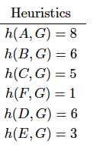
Q2.2: A* Search Solution
A* would return A-D-E-G.
We are Done!
3
2
B
C
F
Priority Queue | Distances | edgeTo
A: 0 + 8 = 8 | A: 0 | —
B: 1 + 6 = 7 | B: 1 | A
D: 2 + 6 = 8 | D: 2 | A
C: 4 + 5 = 9 |  | B
E: 5 + 3 = 8 | E: 5 | D
F: inf
G: 5 + 3 = 8 | G: 8 | E
1
1
4
A
G
2
D
E
3
3

Slide 68
Q2.2: A* Search Solution
A* runs in a very similar fashion to Dijkstra's. The only difference is the priority in the priority queue. For A*, whenever computing the priority (for the purposes of the priority queue) of a particular node n, always add h(n) to whatever you would use with Dijkstra's.
A* would return A-D-E-G.

Slide 69

Q2.3 Solution
Is the heuristic admissible? Why or why not?

Slide 70
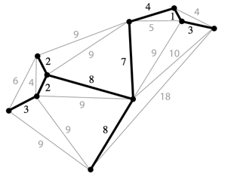
Minimum Spanning Trees (MSTs)
Given an undirected graph G, an MST is the subgraph of G that is a tree of minimum total weight that includes all of its vertices (this is the spanning part)
Note that a tree is has to be acyclic (no cycles), and connected
The uniqueness of an MST is only guaranteed if the graph has distinct edges
Spanning tree is outlined in black here
Notes:
Notes from Hug’s Sp2018 lec 30

Slide 71
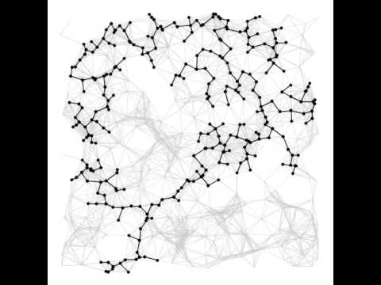
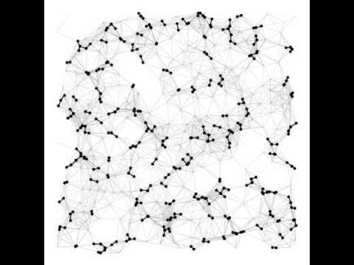
Prim’s vs. Kruskal’s
Prim’s
Kruskal’s
Notes:
From Hug’s 2018 lec 30

Slide 72
Prim’s vs. Kruskal’s
They are both ways of finding an MST, but they don’t always output the same MST
Prim's attaches a new edge to a single growing tree at each step (another way to think of it is that it engulfs nodes)
On the other hand, Kruskal’s processes edges in the order of their edge weights at each step, and takes for the MST each edge that does not form a cycle with edges previously added.
Notes:
definitions of prim’s and kruskal’s from https://algs4.cs.princeton.edu/43mst/

Slide 73

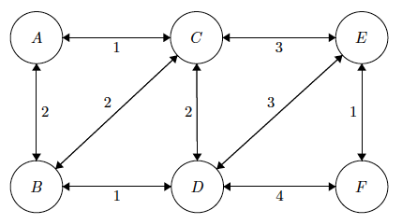
Q3.1

Slide 74
Q3.1 Solution
Begin by engulfing A.
Our current tree is A. Edges going out from our current tree are AC and AB.
The cheapest edge from that tree is AC, so we engulf C.

Slide 75
Q3.1 Solution
Now our current tree is AC.
Edges going out of AC are AB, BC, CD, and CE
The cheapest edge is AB, so we engulf B.

Slide 76
Q3.1 Solution
Now our current tree is ABC.
Edges going out of ABC are BD, CD and CE.
The cheapest is BD, so we engulf D.

Slide 77
Q3.1 Solution
Now our current tree is ABCD.
Edges going out of ABCD are CE, DE, and DF.
The cheapest and lexicographically smallest edge is CE, so we engulf E.

Slide 78
Q3.1 Solution
Finally, we take EF.
Our MST is outlined in brown.

Slide 79
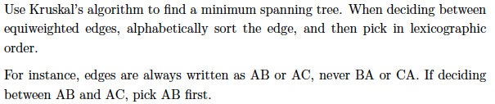
Q3.2

Slide 80
Q3.2
Kruskal’s considers edges of weight 1 first (AC, BD, EF)
It picks AC, then BD, then EF since picking all 3 does not create a cycle

Slide 81
Q3.2
Kruskal’s considers edges of weight 2 next (AB, BC, CD)
It adds AB b/c it doesn’t create a cycle.
It skips BC b/c it creates a cycle
It skips CD b/c it creates a cycle

Slide 82
Q3.2
Kruskal’s now considers edges of weight 3 (CE, DE)
It adds CE b/c it doesn’t create a cycle.
We stop b/c we now have a spanning tree
The full MST is outlined in brown

